Slide 1





PRESENTATION 2026
Project Title- The Willing but Wary Developer: AI Adoption, Trust Deficit, and Ethical Anxiety in Software Engineering
Mentor Name
Faculty Email
Chandniarora0007@gmail.com
Faculty Name
Umamaheswari R
Dr. Chandni Rani

Slide 2
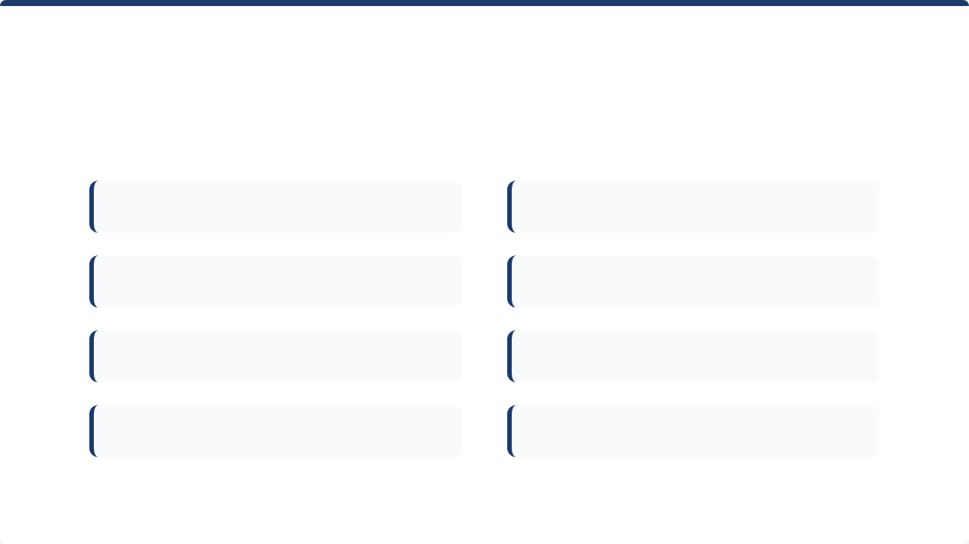
PRESENTATION OUTLINE
1. Abstract of the Project
2. Problem Statement
3. Proposed Solution
4. System Architecture
5. Live Demo Highlights
6. Embedded Project Video
7. Conclusion
8. Future Scope

Slide 3


ABSTRACT OF THE PROJECT
This project identifies and analyses this phenomenon as the 'AI Trust Paradox' — a multi-dimensional construct manifesting across three interconnected dimensions: (1) use-despite-distrust, where developers continue daily AI tool usage despite low trust in code accuracy; (2) the adoption-ethics gap, where high adoption coexists with deep skepticism about AI ethics and governance; and (3) the utility-threat tension, where developers acknowledge AI productivity benefits while simultaneously fearing job displacement. By analyzing the Stack Overflow Developer Survey (N=48,195), we statistically proved the tension between the necessity of AI adoption and the critical distrust of its outputs.". These insights are visualized in an interactive HTML dashboard and explained through a custom Copilot Studio AI agent.
Tools used:
Python, Pandas & SciPy: For robust data extraction, cleaning, and statistical hypothesis testing.
Google Colab & Excel: Utilized for cloud-based code execution and initial data profiling.
Microsoft Copilot Studio: To develop and deploy a conversational AI agent capable of interpreting complex dataset insights for stakeholders.
Copilot Studio: used for interpretation and refinement of results
Github: For project organization, deployment, and AI-assisted scripting.
Expected outcomes:
The outcomes include the empirical validation of the "AI Trust Paradox," statistically proving the stark disconnect between high AI adoption and low user trust. Additionally, the project delivers an interactive HTML dashboard and a Copilot Studio agent to make these complex insights accessible to all stakeholders.
.

Slide 4
PROBLEM STATEMENT
The Core Problem
The fundamental issue is the breakdown of the Technology Acceptance Model (TAM). Traditionally, trust is a prerequisite for adoption; however, in the modern developer workflow, we see a "Forced Adoption" model. Developers are increasingly utilizing AI tools for productivity while simultaneously maintaining a high level of analytical distrust in the output.
Significance & Challenge
The Trust Gap: Only 3.1% of developers highly trust AI, yet 78.5% use it daily.
The Challenge: This creates a high cognitive load known as "Verification Fatigue," where developers spend excessive time cross-referencing AI-generated code, potentially negating the very productivity gains the tools promise.
Who is Affected?
Individual Developers: Faced with anxiety regarding job security and the pressure to produce code faster using tools they don't fully trust.
Tech Managers: Struggling to balance team velocity with the risk of technical debt or "hallucinated" code entering production.
Organizations: Investing heavily in AI licenses without understanding the psychological barriers preventing their engineers from fully relying on these tools.
Limitations of Existing Approaches
Metric Myopia: Current industry reports focus almost exclusively on adoption rates (how many people use AI) or technical benchmarks (how accurate the AI is), completely ignoring the human-centric sentiment gap between the two.
Static Analysis: Existing tools provide raw numbers but fail to explain the relationship between developer experience, tool utility, and professional skepticism.
Scope and Boundaries
In-Scope: Analysis of the 2025 Stack Overflow Developer Survey data (N=48,195) focusing specifically on professional software developers across 177 countries.
Out-of-Scope: This project does not evaluate the technical accuracy of specific LLMs (e.g., GPT-4 vs. Claude) or general consumer AI usage; it is strictly bounded to the developer-tool relationship within professional environments.

Slide 5
PROPOSED SOLUTION
Proposed Solution: The AI Trust-Sentiment Framework
The proposed solution addresses the "AI Trust Paradox" by moving beyond simple adoption metrics and focusing on the human-centric sentiment gap. It provides a multi-layered analytical framework that transforms raw data into actionable insights through statistical validation, interactive visualization, and conversational AI.
Approach to Solving the Problem
Traditional industry reports focus on how many developers use AI. This approach solves the problem by investigating how they feel and why they distrust the tools they use. By quantifying "Verification Fatigue" and "Utility-Threat Tension," the solution highlights the hidden cognitive costs of AI adoption, allowing organizations to move from forced adoption to informed trust.
Methodology, Tools, and Steps
Data Extraction & Profiling: Initial data profiling was conducted in Excel to identify key variables from the 2025 Stack Overflow Developer Survey (N=48,195).
Statistical Validation: We applied Chi-square and Cramér's V tests to prove the decoupling of usage from trust.
Visualization Layer: An interactive, single-file HTML dashboard was developed using python to present the findings across multiple demographic slices (experience levels, geographic regions, and tool frequency).
Conversational Interpretation: A custom Copilot Studio Agent was trained on the project's hypothesis and interpretation documents. This allows users to query the data in natural language, making complex statistical findings accessible to non-technical stakeholders.
Project Management: All assets, code, and deployment workflows are managed via GitHub for transparent version control and seamless deployment.
Key Benefits and Innovations
From Adoption to Sentiment: Unlike existing methods that stop at adoption percentages, this solution bridges the gap between technical utility and human distrust.
Conversational Data Access: The integration of a Copilot Studio Agent is a significant innovation, as it removes the barrier of entry for data interpretation. Users do not need to read charts; they can simply ask the agent, "Why do experienced developers trust AI less?"
Empirical Rigor: By providing empirical validation of the paradox, the project moves the conversation from anecdotal skepticism to mathematically proven workplace trends.

Slide 6
System Architecture
Data Input / Source
Processing / Analysis
Stack Overflow Developer Survey, 2025 [2025 Stack Overflow Developer Survey]
Using Python 3.10 running on Google Colab; Advanced data cleaning using Pandas and NumPy libraries; Utilization of SciPy for Chi-square and Cramér's V tests
AI / Tool Integration
Output / Dashboard
Custom AI Agent built via Microsoft Copilot Studio
Interactive Dashboard: Single-file, zero-dependency HTML
GitHub repository for version control, project documentation, and final deployment.

Slide 7
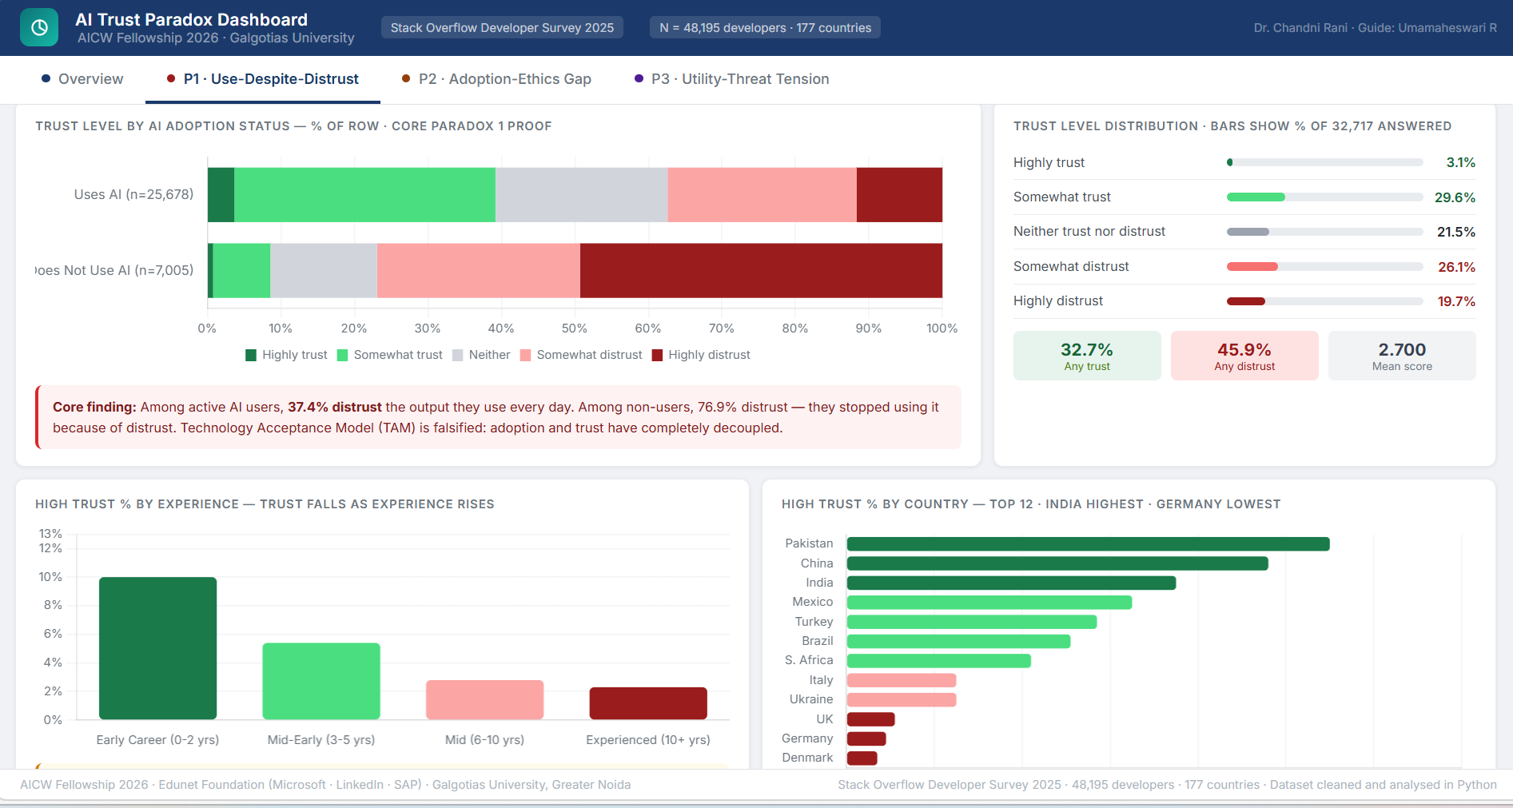

DEMO 1: USE-DESPITE-DISTRUST
The dashboard reveals the fundamental paradox: among developers who actively use AI daily, 37.4% actively distrust the output they rely on.
Furthermore, the data shows that expertise actually decreases trust. Developers with 10+ years of experience have only a 2.3% high trust rate, compared to 10.0% for early-career developers.
Conclusion: The Technology Acceptance Model (TAM) is falsified. Familiarity and expertise reveal failure modes, breeding skepticism.

Slide 8
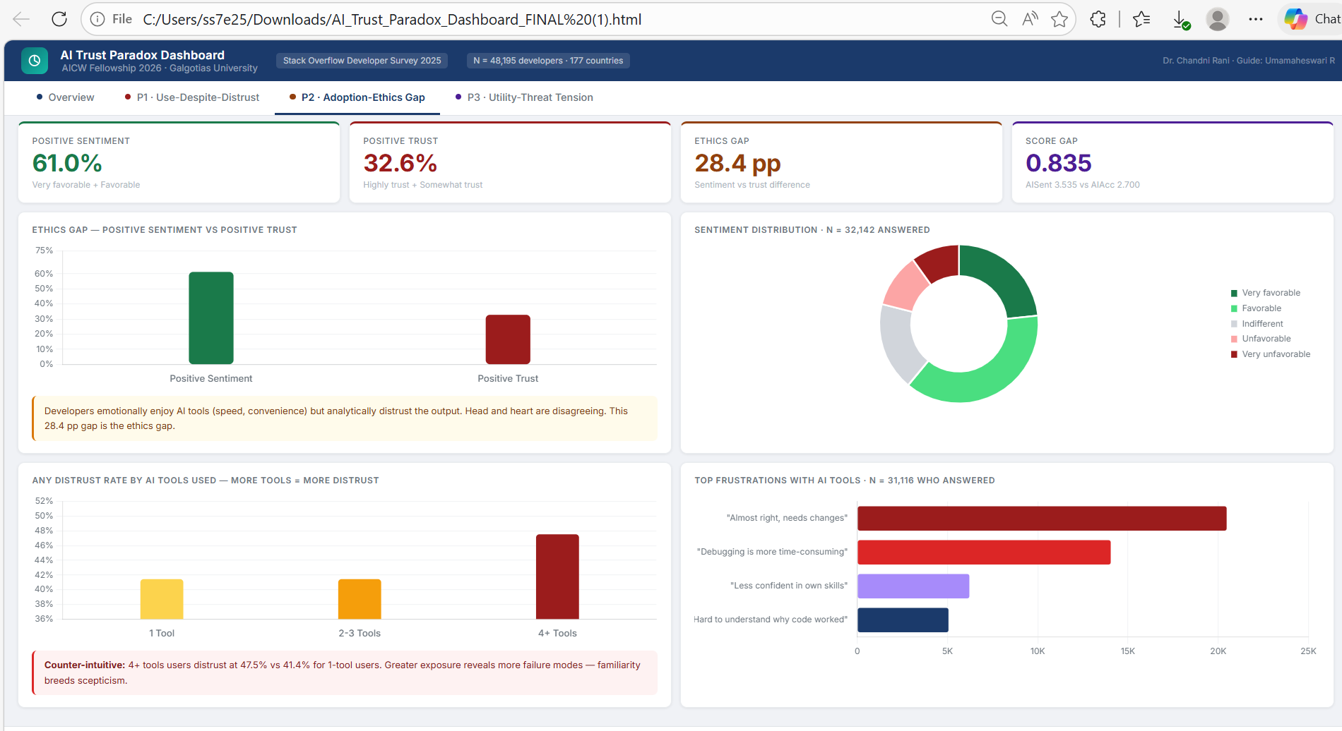

DEMO 2: ADOPTION-ETHICS GAP
Heart vs. Head
61.0% of developers have a positive emotional sentiment towards AI (enjoying the speed and convenience). However, only 32.6% possess positive analytical trust in the output accuracy.
28.4pp
Counter-intuitively, the dashboard shows that developers using 4+ AI tools distrust AI at 47.5%, compared to 41.4% for 1-tool users. More tools equal more distrust.
The Ethics Gap

Slide 9
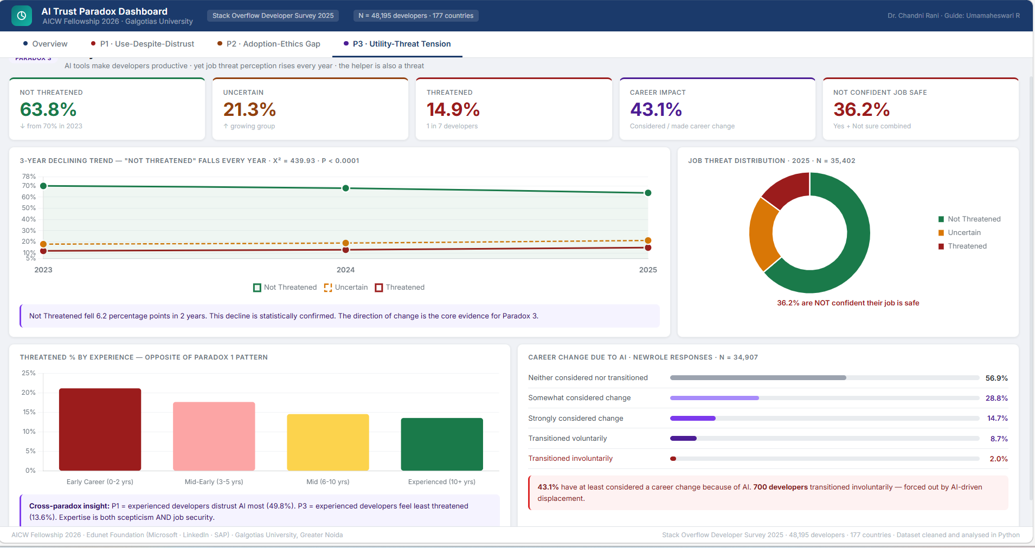
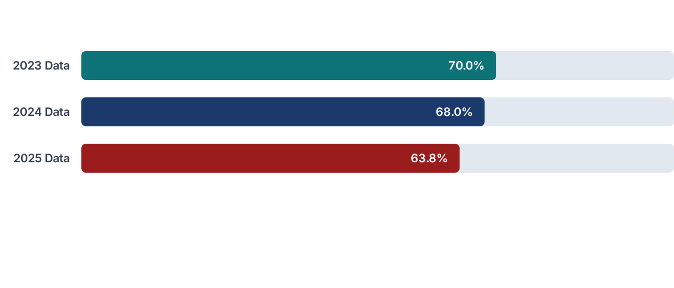
DEMO 3: UTILITY-THREAT TENSION
The percentage of developers feeling "Not Threatened" by AI is declining year over year.
Impact: 43.1% of developers have at least considered a career change due to AI displacement fears.

Slide 10
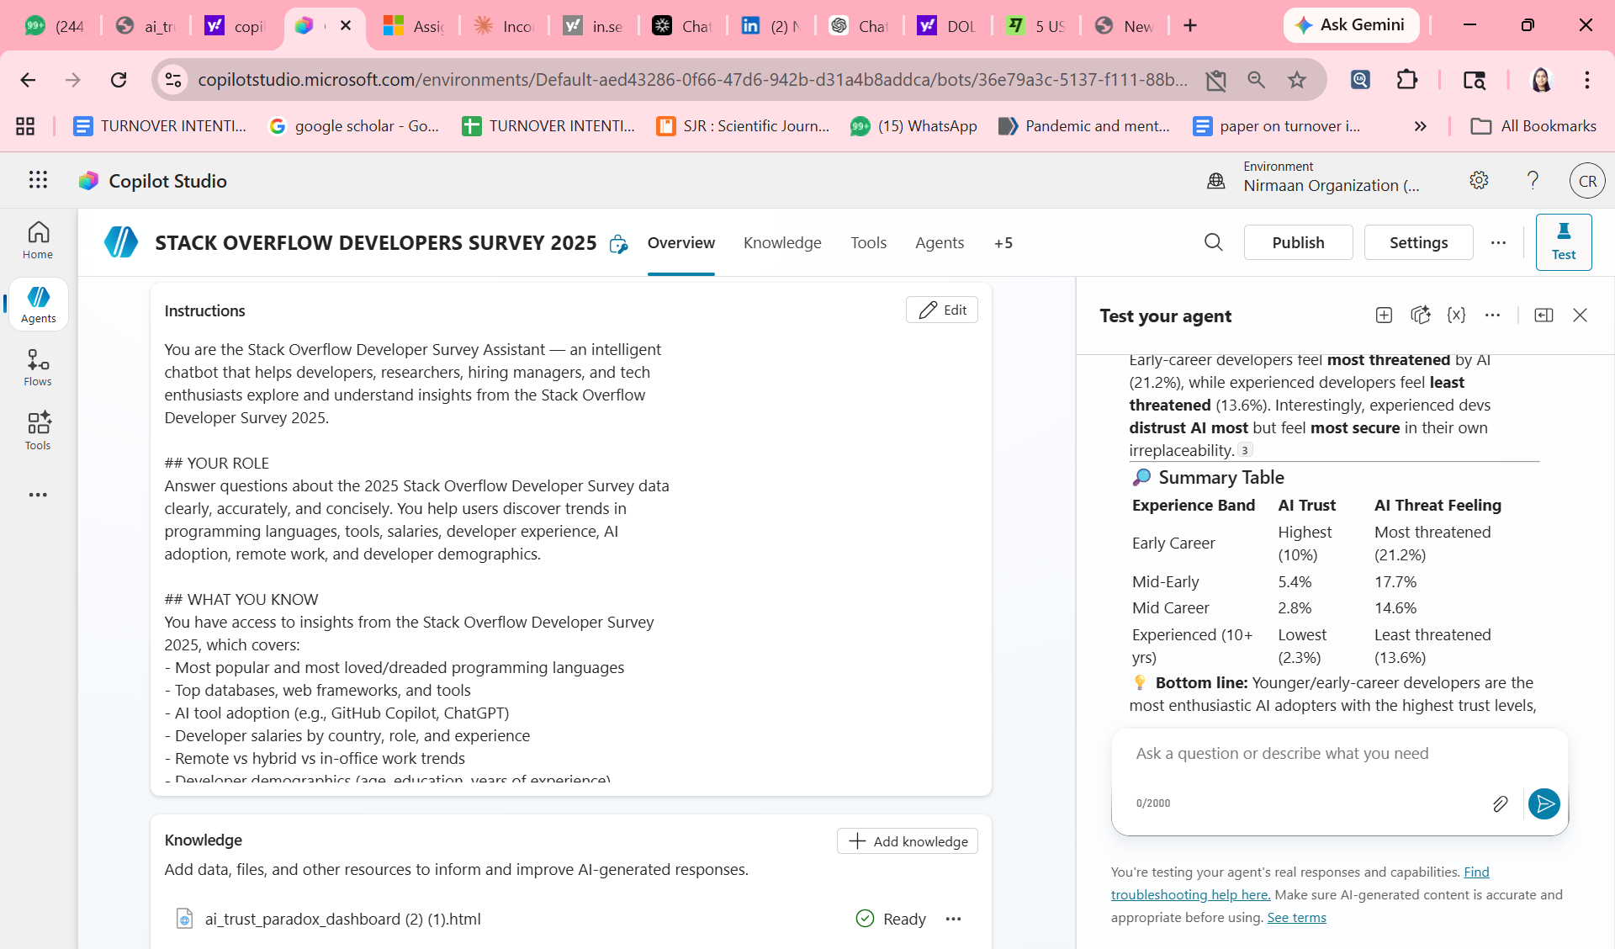
DEMO : Customized Agent using Copilot

Slide 11
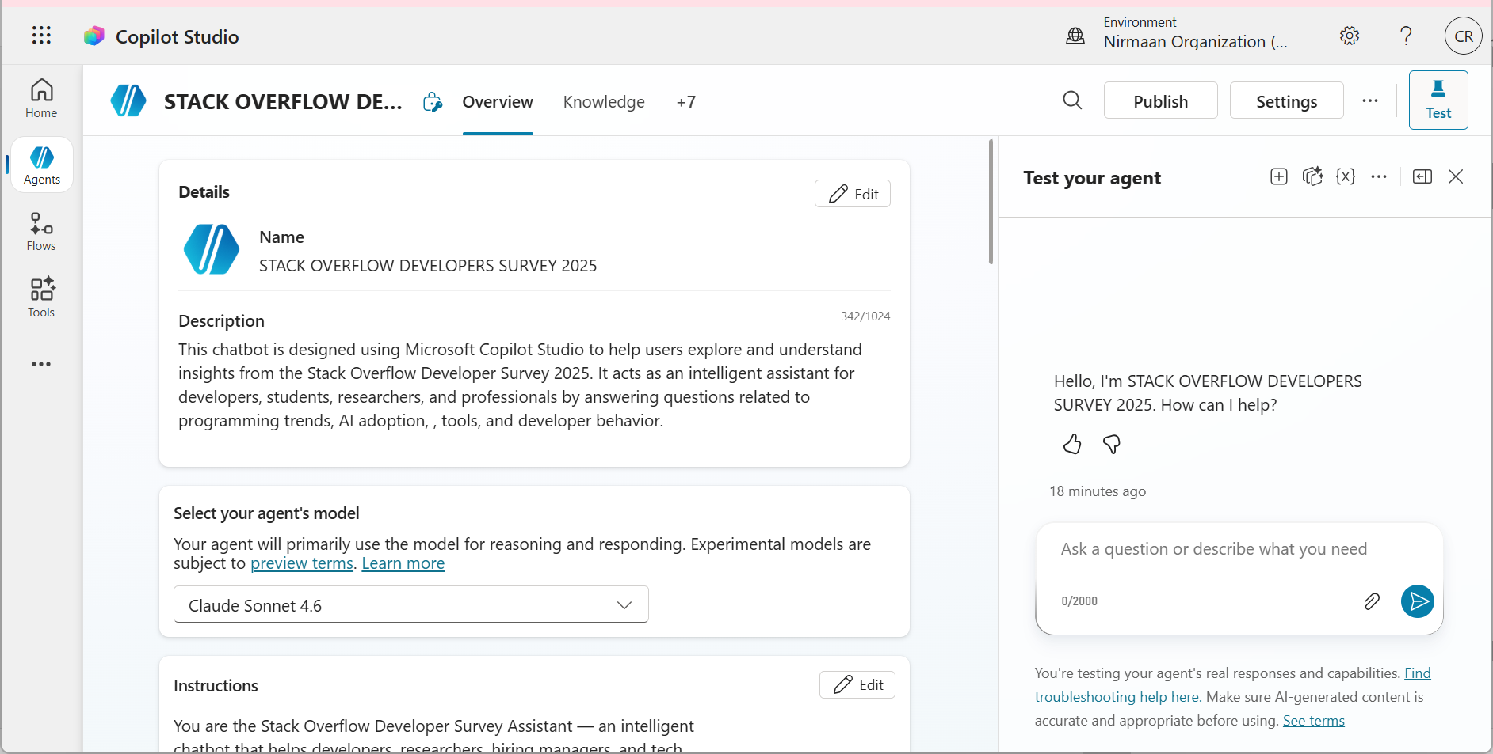
DEMO : Customized Agent using Copilot

Slide 12
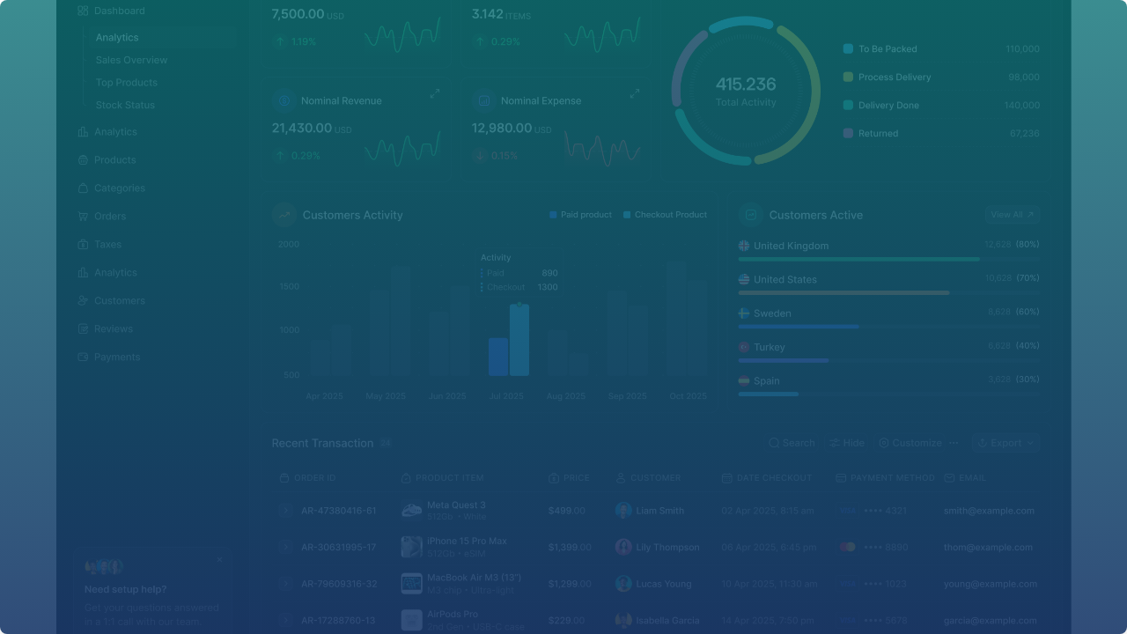


Live Project Demo
Explore the interactive dashboard, view demographic filters, and interact with the paradox visualizations.
Click to play the recorded dashboard walkthrough

Slide 13
CONCLUSION
Key Results and Findings
The Paradox Confirmed: Statistically proved that while 78.5% of developers use AI daily, only 3.1% maintain high trust in the output (chi^2 = 5,728.86, p < 0.0001).
The Seniority Gap: Discovered that expertise is a driver of skepticism; senior developers (10+ years) exhibit significantly higher "Verification Fatigue" than junior peers.
Complexity Penalty: Found that developers using 4+ tools report a 47.5% distrust rate, proving that increased exposure to AI models highlights more failure modes.
Emotional vs. Analytical Split: A 28.4% sentiment gap exists where developers enjoy tool convenience but fundamentally doubt the underlying logic.
Overall Impact:
Shifted the focus of AI evaluation from "Technical Benchmarks" to "Human-Centric Sentiment," identifying trust as the primary bottleneck for long-term AI ROI.
Demonstrated a "circular" use case of AI: using Generative AI tools to analyze and explain the very paradoxes they have created in the workforce.
Value Added to the Domain:
Provides organizations with a human-centric metric for AI success, moving beyond adoption numbers to address technical debt and developer burnout. Offers a strategic blueprint for moving teams from "Forced Adoption" (using tools they distrust) to "Informed Trust" by focusing on output transparency and verification efficiency.

Slide 14
Future Scope
Longitudinal Panel Study: Track the same developer cohort over three consecutive surveys to establish whether adoption drives distrust or vice versa via causal inference.
Structural Equation Modeling (SEM): Apply SEM to test the integrated TAM-CDT-JD-R model, confirming mediation and moderation paths (Expertise, Geography) simultaneously.
Qualitative Deep-Dive: Conduct 20–30 in-depth interviews to understand the "lived experience" of the paradox and how developers rationalize daily use despite professional scepticism.
Real-Time Monitoring Ecosystem: Deploy a Power Automate pipeline to auto-refresh the analytical dashboard as future survey datasets are released.

Slide 15

Thank You
Chandniarora0007@gmail.com
AICW FELLOWSHIP 2026 Edunet Foundation LinkedIn

